Slide 1
Unit-9 Searching
Compiled by:
Ghanashaym BK

Slide 2
Introduction to Search Technique
Searching in data structure refers to the process of finding the required information from a collection of items stored as elements in the computer memory.
These sets of items are in different forms, such as an array, linked list, graph, or tree.
Another way to define searching in the data structures is by locating the desired element of specific characteristics in a collection of items.
These algorithms are classified according to the type of search operation they perform:
Sequential search
The list or array of elements is traversed sequentially while checking every component of the set.
For example – Linear Search.
Interval Search
The interval search includes algorithms that are explicitly designed for searching in sorted data structures. In terms of efficiency, these algorithms are far better than linear search algorithms.
Example- Logarithmic Search, Binary search.

Slide 3
Dictionary
Dictionary (map, association list) is a data structure, which is generally an association of unique keys with some values.
One may bind a value to a key, delete a key (and naturally an associated value) and lookup for a value by the key.
Values are not required to be unique.
Simple usage example is an explanatory dictionary. In the example, words are keys and explanations are values.

Slide 4
Dictionary as ADT
Dictionary create(): creates empty dictionary
boolean isEmpty(Dictionary d): tells whether the dictionary d is empty
put(Dictionary d, Key k, Value v): associates key k with a value v; if key k already presents in the dictionary old value is replaced by v
Value get(Dictionary d, Key k): returns a value, associated with key k or null, if dictionary contains no such key
remove(Dictionary d, Key k): removes key k and associated value
destroy(Dictionary d): destroys dictionary d

Slide 5
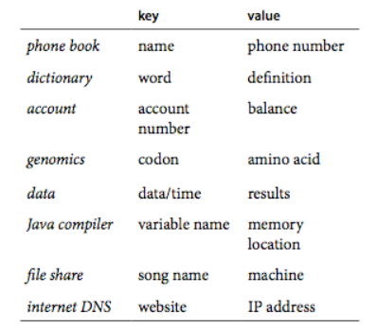
Applications of Searching

Slide 6
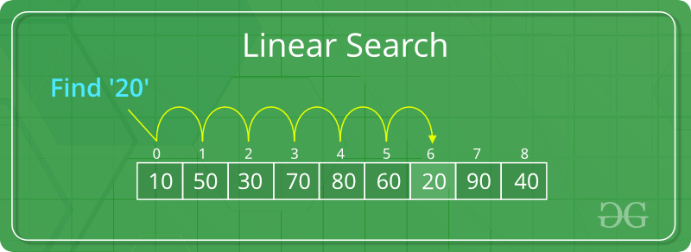
Sequential Search
Linear search is a sequential searching algorithm where we start from one end and check every element of the list until the desired element is found.
It is the simplest searching algorithm.
It sequentially checks each element of the list for the target value until a match is found or until all the elements have been searched.

Slide 7

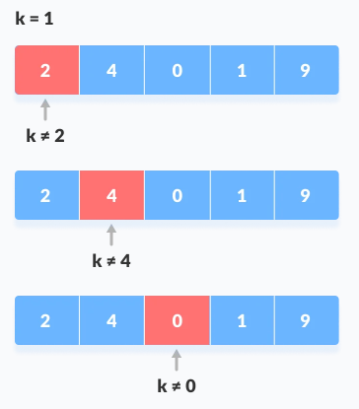
How Linear Search Work?
steps to be followed to search for an element k = 1.
Array to be searched for
Start from the first element, compare k with each element x.

Slide 8
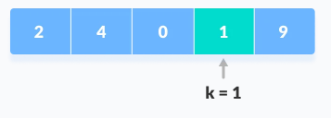
How Linear Search Work?
If x == k, return the index. Element Found.
Else, return not Found.
Pseudocode
LinearSearch(array, key)
for each item in the array
if item == value
return its index
C Function
int search(int array[], int size, int key) {
// Going through array sequencially
for (int i = 0; i < size; i++)
if (array[i] == key)
return i;
return -1;
}

Slide 9
Efficiency of Sequential Search
Time complexity
Best Case: O(1)
Locate desired item at first.
Worst Case: O(n)
Most look at all the item.
Average Case: O(n)
Must look at half the items.
O(n/2) is just O(n).
Space Complexity: O(1)

Slide 10
Binary Search
Binary Search is a searching algorithm for finding an element's position in a sorted array.
In this approach, the element is always searched in the middle of a portion of an array.
Binary search can be implemented only on a sorted list of items. If the elements are not sorted already, we need to sort them first.
The logic behind this technique is given below:
First find the middle element of the array
compare the middle element with an item.
There are three cases:
If it is a desired element then search is successful
If it is less than desired item then search only the first half of the array.
If it is greater than the desired element, search in the second half of the array.
Repeat the same process until element is found or exhausts in the search area.

Slide 11

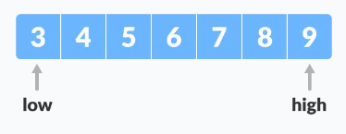
Working of binary search
Steps for binary search
Step-1 The array in which searching is to be performed is:
Let x = 4 be the element to be searched.
Step-2 Set two pointers low and high at the lowest and the highest positions respectively.

Slide 12
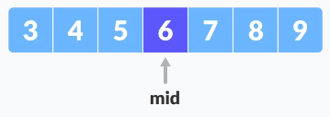
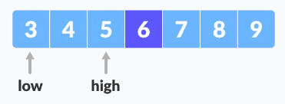
Working of binary search
Step-3 Find the middle element mid of the array ie. arr[(low + high)/2] = 6.
Step-4 If x == mid, then return mid.Else, compare the element to be searched with m.
Step-5 If x > mid, compare x with the middle element of the elements on the right side of mid. This is done by setting low to low = mid + 1.
Step-6 Else, compare x with the middle element of the elements on the left side of mid. This is done by setting high to high = mid - 1.

Slide 13
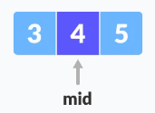
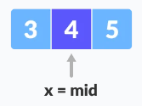
Working of binary search
Step-7 Repeat steps 3 to 6 until low meets high.
Step-8 x==4 is found.

Slide 14
Binary Search
Pseudocode
do until the pointers low and high meet each other.
mid = (low + high)/2
if (x == arr[mid])
return mid
else if (x > arr[mid]) // x is on the right side
low = mid + 1
else // x is on the left side
high = mid - 1
C Function
int binarySearch(int array[], int key, int low, int high) {
// Repeat until the pointers low and high meet each other
while (low <= high) {
int mid = low + (high - low) / 2;
if (array[mid] == key)
return mid;
if (array[mid] < key)
low = mid + 1;
else
high = mid - 1;
}
return -1; }

Slide 15
Binary Search
Time complexity
Best Case: O(1)
Worst Case: O(log n)
Average Case: O(log n)
Space Complexity: O(1)

Slide 16
Tree Search
A tree search starts at the root and explores nodes from there, looking for one particular node that satisfies the conditions mentioned in the problem.
Unlike linear data structures, the elements can be traversed in many ways.
There are many algorithms that use different order to traverse/pass through a node.
Depth-First Search (DFS) Algorithm:
It starts with the root node and first visits all nodes of one branch as deep as possible of the chosen Node and before backtracking, it visits all other branches in a similar fashion.
three sub-types: Preorder, Postorder and Inorder Traverse.
Breadth-First Search (BFS) Algorithm:
It also starts from the root node and visits all nodes of current depth before moving to the next depth in the tree.
One variants: Level order Traversal.

Slide 17
Hashing
Hashing is a technique of mapping a large set of arbitrary data to tabular indexes using a hash function.
It is a method for representing dictionaries for large datasets.
Hashing provides the direct access of records from the file no matter where the record is in the file.
Due to which it reduces the unnecessary comparisons.
It allows lookups, updating and retrieval operation to occur in a constant time i.e. O(1)
This technique uses a hashing function say h which maps the key with the corresponding key address or location

Slide 18
Why hashing?
Assume that you have an object and you want to assign a key to it to make searching easy.
To store the key/value pair, you can use a simple array like a data structure where keys (integers) can be used directly as an index to store values.
However, in cases where the keys are large and cannot be used directly as an index, you should use hashing
In hashing, large keys are converted into small keys by using hash functions.
The values are then stored in a data structure called hash table.
The idea of hashing is to distribute entries (key/value pairs) uniformly across an array.
Each element is assigned a key (converted key).
By using that key you can access the element in O(1) time. Using the key, the algorithm (hash function) computes an index that suggests where an entry can be found or inserted.

Slide 19

Hash tables
The Hash table data structure stores elements in key-value pairs where
Key- unique integer that is used for indexing the values
Value - data that are associated with keys.

Slide 20
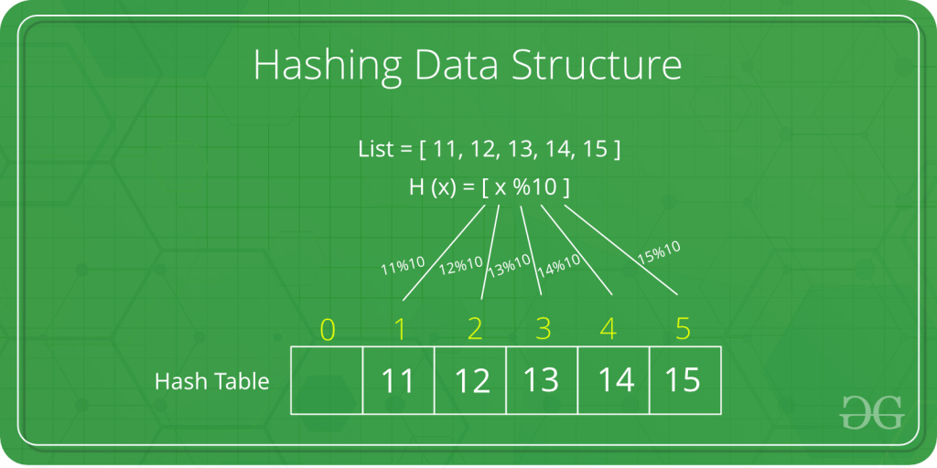
Hash functions
A function that transforms a key into a table index is called a hash function.
The efficiency of mapping depends on the efficiency of the hash function used.
Let a hash function H(x) maps the value x at the index x%10 in an Array.
For example if the list of values is [11,12,13,14,15] it will be stored at positions {1,2,3,4,5} in the array or Hash table respectively.

Slide 21
Collision resolution techniques
When the hash function generates the same index for multiple keys, there will be a conflict (what value to be stored in that index). This is called a hash collision.
We can resolve the hash collision using one of the following techniques.
Collision resolution by chaining: An array of Linked list applications.
Open Addressing: Array based implementation
Linear Probing
Quadratic Probing and
Double Hashing

Slide 22
Collision resolution by chaining
In chaining, if a hash function produces the same index for multiple elements, these elements are stored in the same index by using a linked list.
In this technique, a linked list is created from the slot in which collision has occurred, after which the new key is inserted into the linked list.
This linked list of slots looks like a chain, so it is called chaining.
It is used more when we do not know how many keys to insert or delete.
Time complexity
Its worst-case complexity for searching is O(n).
Its worst-case complexity for deletion is O(n).

Slide 23
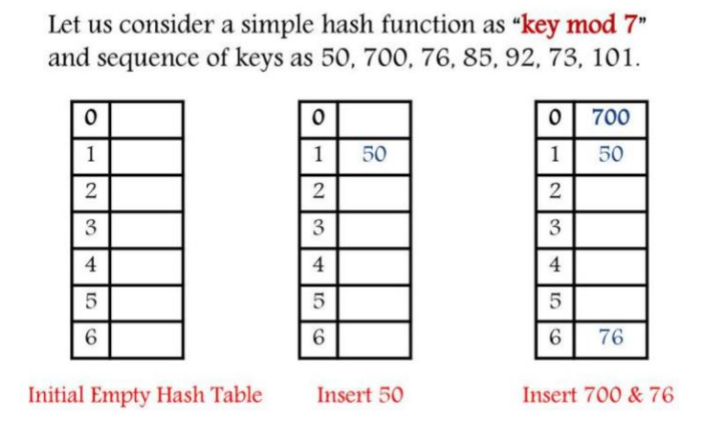
Collision resolution by chaining

Slide 24
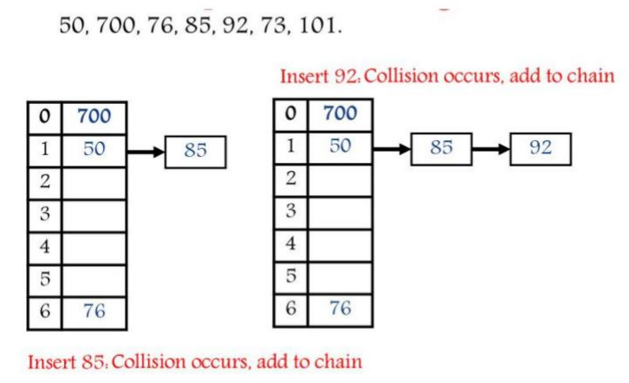
Collision resolution by chaining

Slide 25
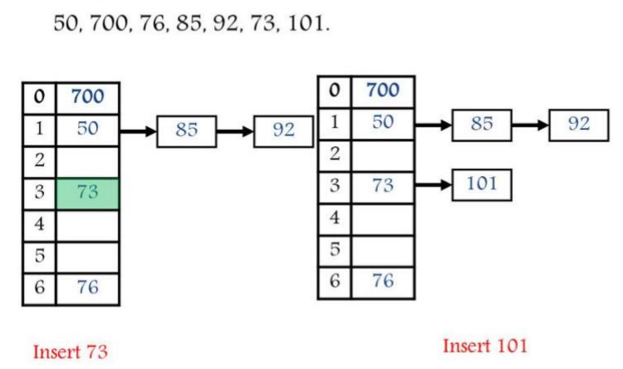
Collision resolution by chaining

Slide 26
Open Addressing
Unlike chaining, open addressing doesn't store multiple elements into the same slot. Here, each slot is either filled with a single key or left NIL
There is no key stored outside of the hash table.
Therefore, the size of the hash table is always greater than or equal to the number of keys.
It is also called closed hashing.
The following techniques are used in open addressing:
Linear Probing
Quadratic Probing and
Double Hashing

Slide 27
Linear Probing
In linear probing, we search the hash table sequentially, starting from the original hash location.
If a location is occupied, we check the next location.
We wrap around from the last table location to the first table location if necessary.
The function for rehashing is the following:
rehash (key)=(n+1)% hash table
If slot hash(x) % tablesize is full, then we try (hash(x) + 1) % tablesize
If (hash(x) + 1) % tablesize is also full, then we try (hash(x)+2)% tablesize
If (hash(x)+2) % tablesize is also full, then we try (hash(x) + 3)% tablesize
And so on until you find the empty slot.

Slide 28
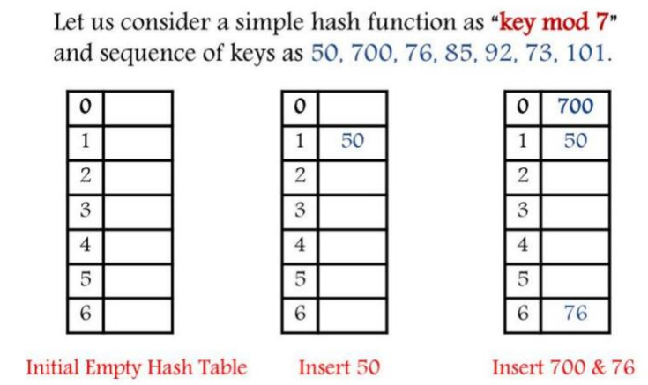
Linear Probing

Slide 29
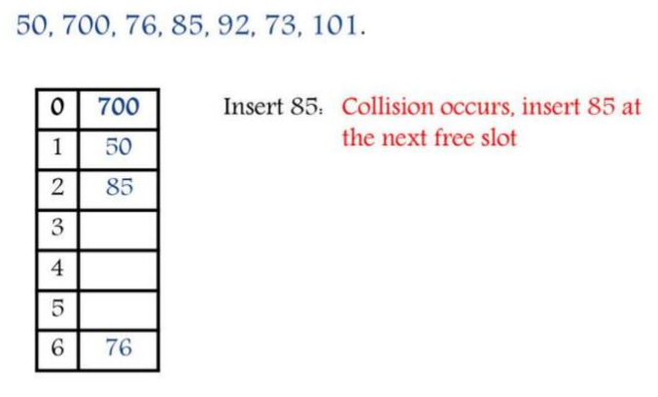
Linear Probing

Slide 30
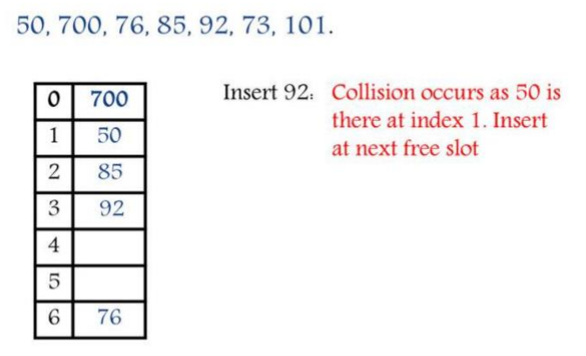
Linear Probing

Slide 31
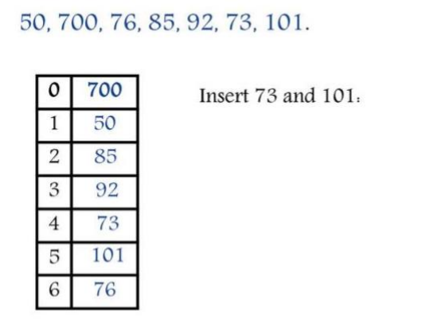
Linear Probing

Slide 32
Quadratic Probing
In quadratic probing, When collision occurs, we probe for i² th bucket in i^{th} iteration.
i.e. In quadratic probing, we start from the original hash location i.
If a location is occupied, we check the locations :H+1²,H+2²,H+3²,H+4²,...,H+k² where i= 1 to k
In quadratic probing, f is a quadratic function of i, typically f(i) = i².
For example: Table.Size = 10, hash(x) = x mod 10, f(i) = i², h(x) = (hash(x) + f(i)) mod Table.

Slide 33
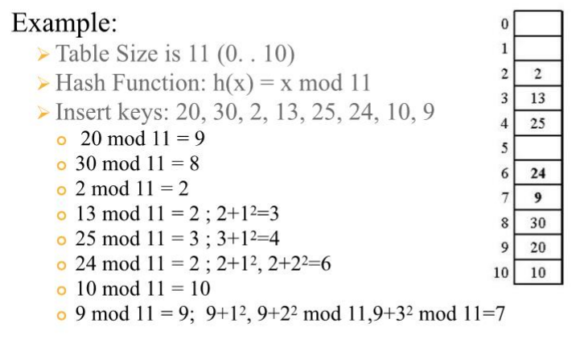
Quadratic Probing

Slide 34
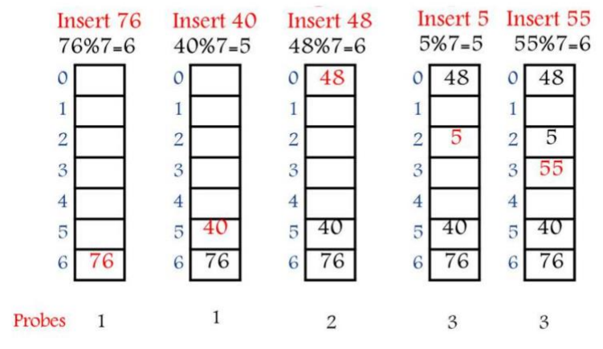
Quadratic Probing

Slide 35
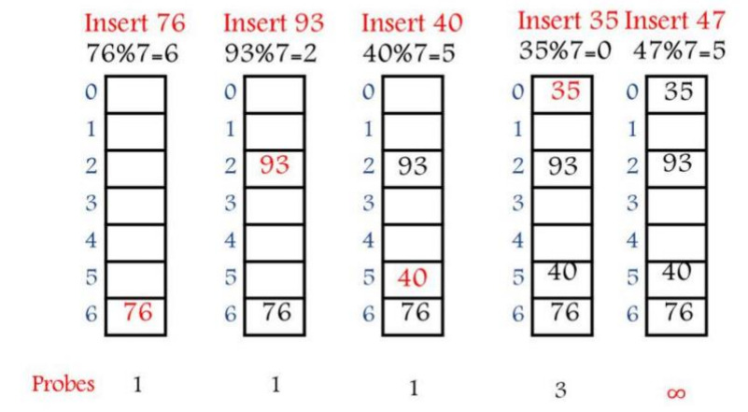
Quadratic Probing

Slide 36
Double hashing
For double hashing, one popular choice is h(x) = (hash₁(x) + f(i))
Where, f(i) = i * hash₂(x) and i = 0,1,2,……
This formula says that we apply a second hash function to x and probe at a distance hash₂(x), 2*hash₂(x), 3*hash₂(x), ..., and so on.
The choice of hash₂(x) is essential.
The function must never evaluate to zero.
It is important to make sure all cells can be probed.
A function such as hash₂(x) = R - (x mod R), with R a prime smaller than Table Size.
Table Size need to be prime.
The cost of double hashing: the use of a second hash function.

Slide 37
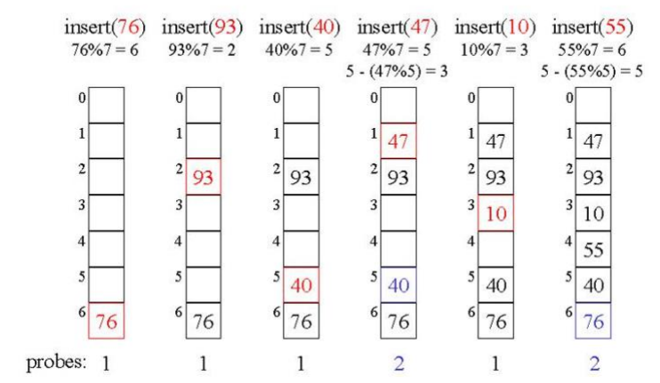
Double hashing

Slide 38
Rehashing
Rehashing is a technique in which the table is resized, i.e., the size of table is doubled by creating a new table.
It is preferable is the total size of table is a prime number.
There are situations in which the rehashing is required.
When table is completely full
With quadratic probing when the table is filled half.
When insertions fail due to overflow
In such situations, we have to transfer entries from old table to the new table by re computing their positions using hash functions.

Slide 39
Rehashing
In such situations, we have to transfer entries from old table to the new table by re computing their positions using hash functions.
H(key) = key mod tablesize
37% 10=7
90% 10=0
55% 10=5
22% 10=2
17% 10 = 7 Collision solved by linear probing
49% 10=9
Now this table is almost full and if we try to insert more elements collisions will occur and eventually further insertions will fail. Hence we will rehash by doubling the table size. The old table size is 10 then we should double this size for new table, that becomes 20. But 20 is not a prime number, we will prefer to make the table size as 23.

Slide 40
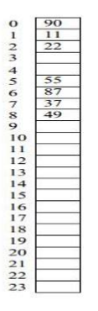
Rehashing
And new hash function will be
H(key) key mod 23
37% 23=14
90% 23=21
55% 23=9
22% 23 = 22
17% 23 = 17
49% 23=3
87% 23 = 18
Now the hash table is sufficiently large to accommodate new insertions
Advantages
This technique provides the programmer a flexibility to enlarge the table size if required.
Only the space gets doubled with simple hash function which avoids occurrence of collisions.

Slide 41
Assignment
Prepare a report on comparison of different search technique along with its efficiency.

